Slide 1
Blockchain Technologies and Cryptocurrencies

Slide 2
What is a blockchain?
Abstract answer: a blockchain provides
coordination between many parties,
when there is no single trusted party
if trusted party exists ⇒ no need for a blockchain
[financial systems: often no trusted party]
Notes:
but blockchains also used in other areas, like digital asset management, e.g., as in online games.

Slide 3
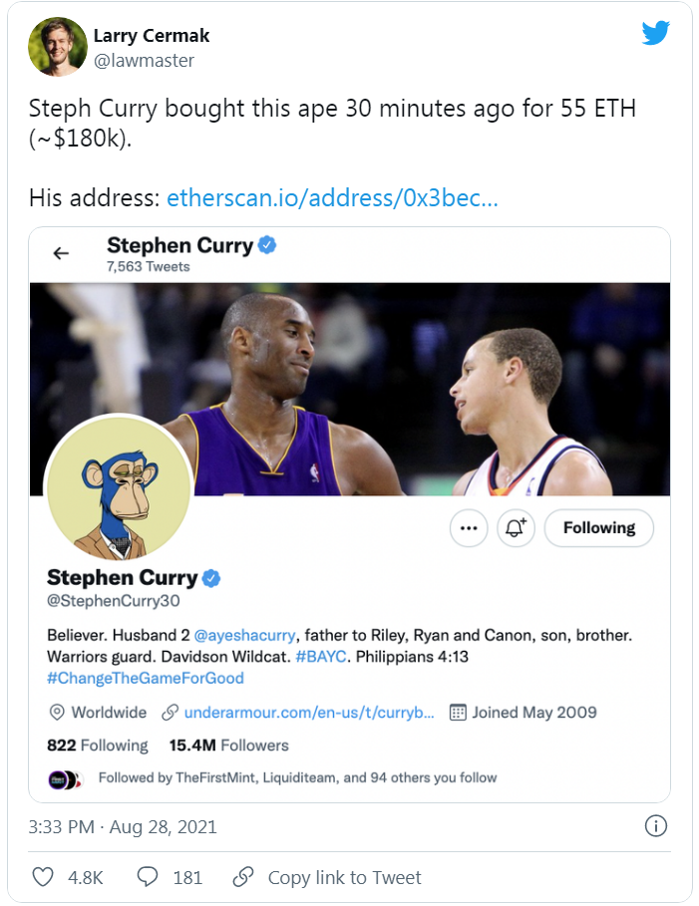
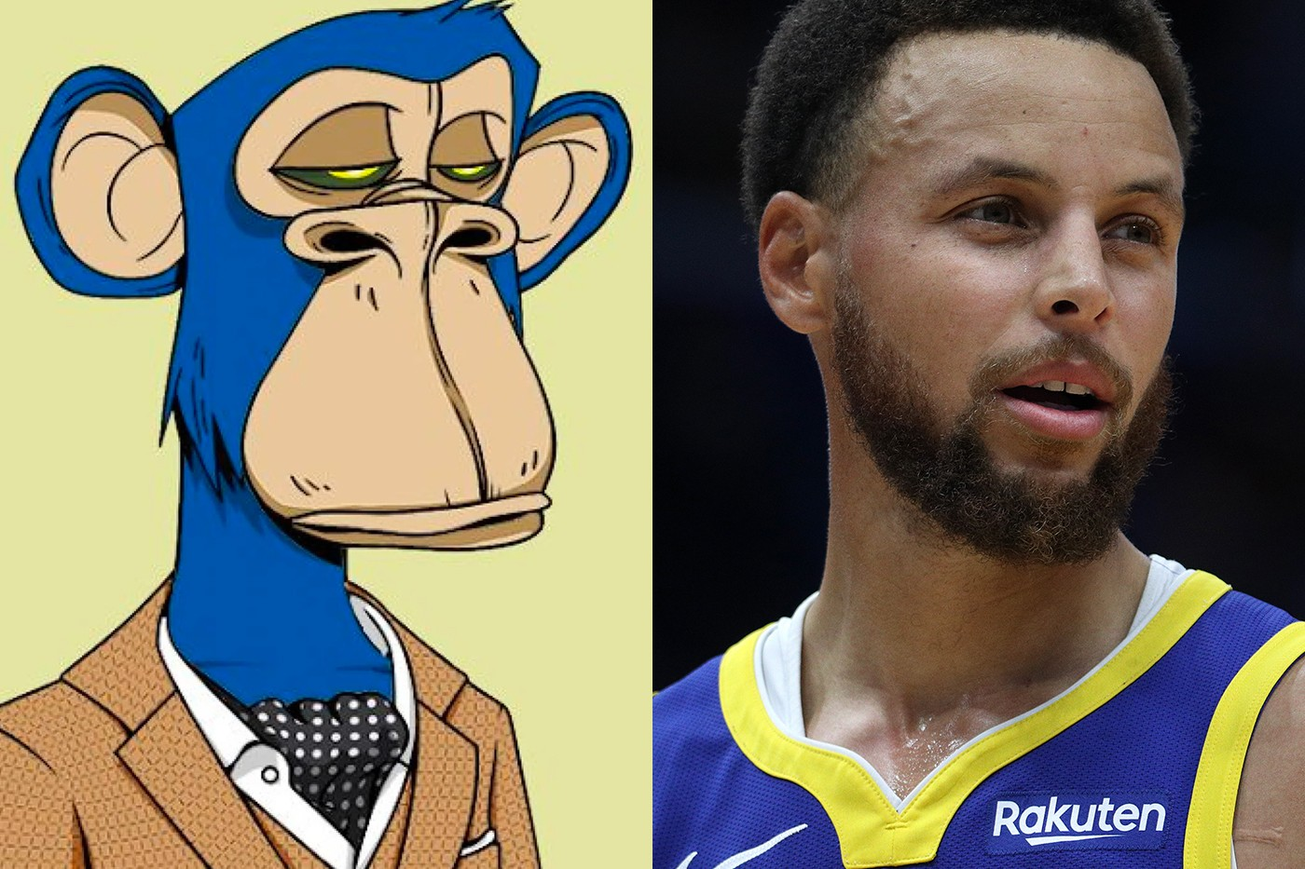
1. N.F.T

Slide 4
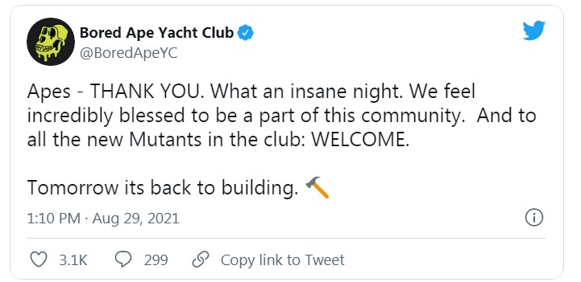
N.F.T
The Bored Ape Yacht Club is quickly gaining traction as a batch of 10,000 Mutant Apes NFTs sold out in an hour on Saturday — raising a total of $96 million USD. In terms of appreciation in the market, the first Bored Ape sold for 0.68 ETH back in May, where just recently, Bored Ape #3749 saw numbers in the 1,500 ETH (~$4.8 million USD) range.

Slide 5
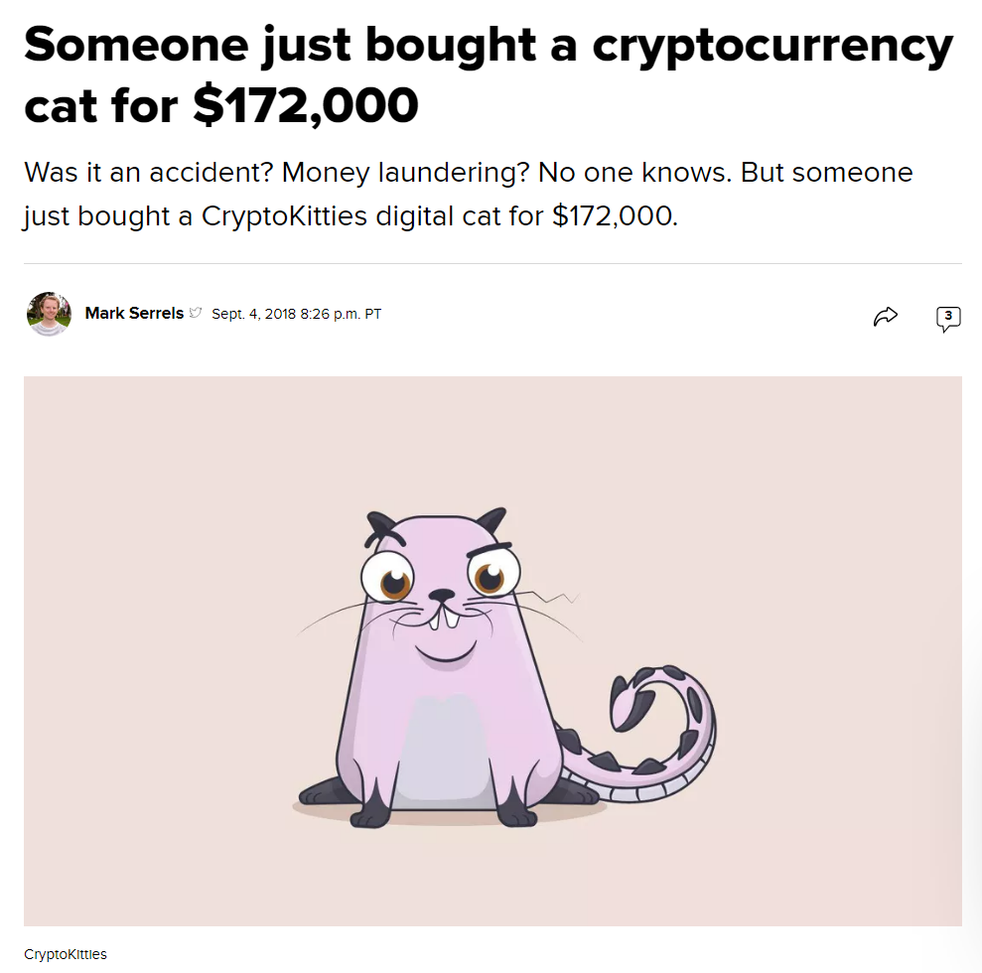
N.F.T
NFT is not new concept

Slide 6
N.F.T
What is N.F.T, anyway?

Slide 7
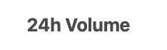
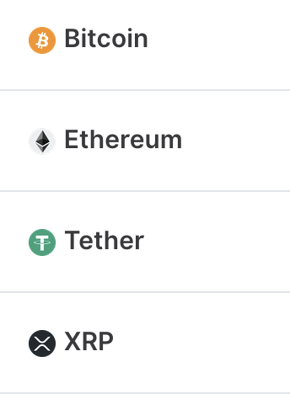
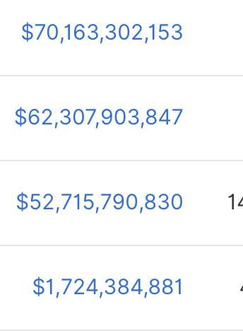
2. Cryptocurrencies Transaction volume
(Sep, 2020)

Slide 8
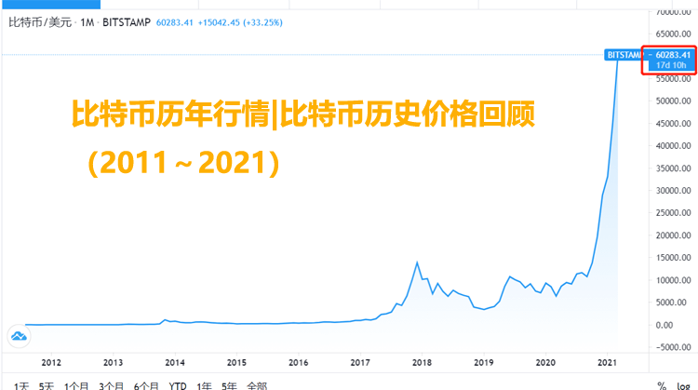
2. bitcoin

Slide 9
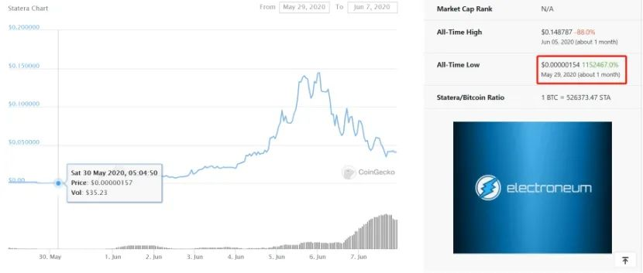
STA (defi)

Slide 10
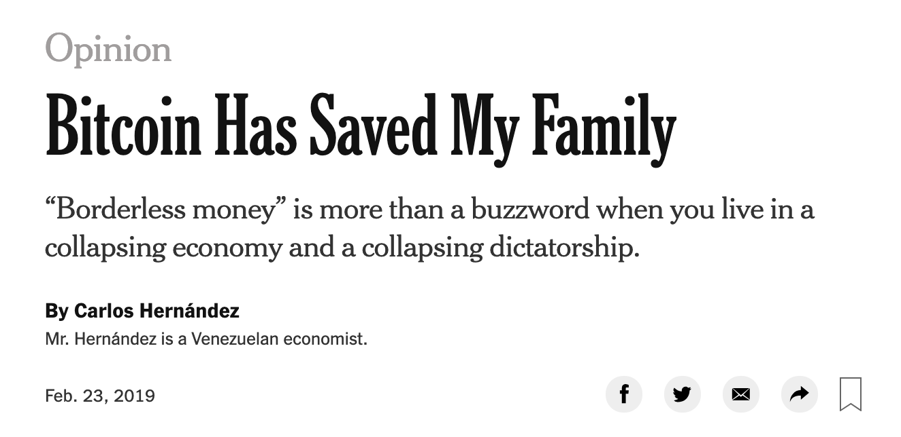
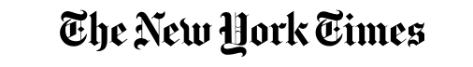
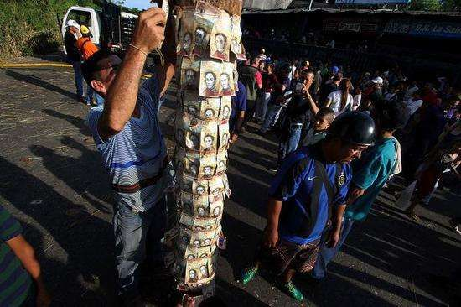
On the other hand
Notes:
CIUDAD GUAYANA, Venezuela — On Tuesday, I went shopping for milk. With the chronic food shortages in Venezuela, that errand already is very complicated, but there’s an extra layer of difficulty for me: I don’t own bolívars, Venezuela’s official currency.
I keep all of my money in Bitcoin. Keeping it in bolívars would be financial suicide: The last time I checked, the rate of daily inflation was around 3.5 percent. That’s daily inflation; the annual inflation rate for 2018 was almost 1.7 million percent. I don’t have a bank account abroad, and with Venezuela’s currency controls, there’s no easy way for me to use a conventional foreign currency like American dollars.
Things just keep getting crazier here. Venezuela now has two presidents. One of them, Nicolás Maduro, wants to take on the British billionaire Richard Branson in a competition of charity concerts. While we Venezuelans are going hungry, there have been violent standoffs over humanitarian aid piling up at the borders with Colombia and Brazil. And before I can buy milk, I need to convert Bitcoins into bolívars.

Slide 11


3. A Game
Imagine your friend is color-blind.
You have two billiard balls; one is red, one is yellow, but they are otherwise identical.
To your friend, they seem completely identical, and he is skeptical that they are actually distinguishable. You want to prove to him that they are in fact differently-colored. On the other hand, you do not want him to learn which is red and which is yellow.

Slide 12
3. A game
Proof system:
You give the two balls to your friend so that he is holding one in each hand.
You can see the balls at this point, but you don't tell him which is which.
Your friend then puts both hands behind his back. Next, he either switches the balls between his hands, or leaves them be.
Finally, he brings them out from behind his back. You now have to "guess" whether or not he switched the balls.

Slide 13
3. A Game
Proof system:
By looking at their colors, you can determine whether or not he switched them. If they were the same color, there is no way you could guess correctly with probability higher than 1/2.
If you and your friend repeats this T times (for large T), your friend should become convinced that the balls are indeed differently colored; otherwise, the probability that you would have succeeded at identifying all the switch/non-switches is at most (1/2)^{T}
Furthermore, the proof is "zero-knowledge" because your friend never learns which ball is yellow and which is red; indeed, he gains no knowledge about how to distinguish the balls.

Slide 14
3. A Game
What is point?
How is a voting blockchain feasible if the government can see how everyone votes?
The answer is a zero knowledge proof
This means that you provide cryptographic proof that you are a valid owner of a voting token – yet you do not have to reveal who you are.

Slide 15
What is Blockchain?

Slide 16
What is a blockchain?
Abstract answer: a blockchain provides
coordination between many parties,
when there is no single trusted party
if trusted party exists ⇒ no need for a blockchain
[financial systems: often no trusted party]
Notes:
but blockchains also used in other areas, like digital asset management, e.g., as in online games.

Slide 17
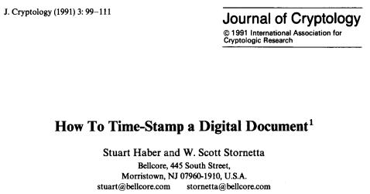

Blockchain is a technology
There is no “the” blockchain … blockchain is a technology.
Concept invented by Haber and Stornetta (1991) in the context of time-stamping digital documents.
Also, blockchain is not bitcoin. Bitcoin uses a blockchain technology. (but it is not until the bitcoin that blockchain becomes well known)

Slide 18
Blockchain is a ledger
A very special ledger…
Quickly and easily accessed and shared by many -- distributed

Slide 19
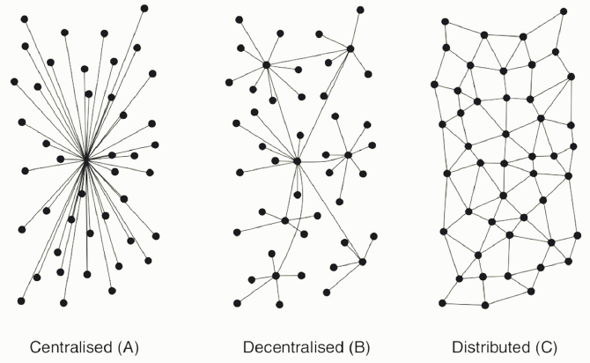
Blockchain is a ledger
A very special ledger…
Quickly and easily accessed and shared by many -- distributed

Slide 20
Blockchain is a ledger
A very special ledger…
Quickly and easily accessed and shared by many -- distributed
Various levels of transparency depending on application
Immutable (you can only add to it – you cannot alter history)

Slide 21
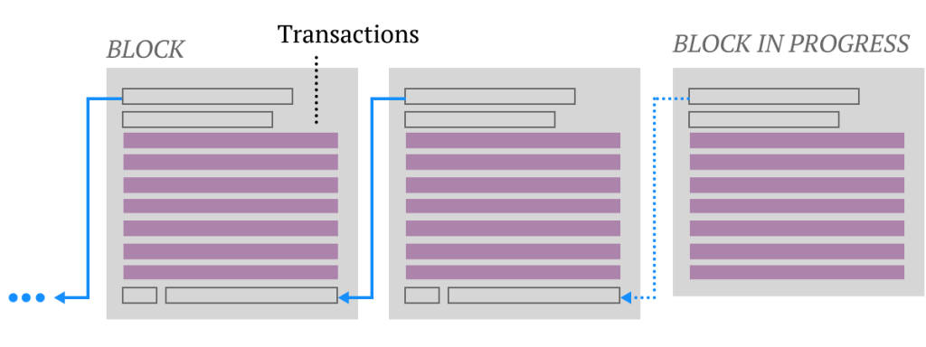
Blockchain is a ledger
A very special ledger…
Quickly and easily accessed and shared by many -- distributed
Various levels of transparency depending on application
Immutable (you can only add to it – you cannot alter history)
Cryptographically secured

Slide 22
What is all the excitement about?
(1) Basic application: a digital currency (stored value)
Current largest: Bitcoin (2009), Ethereum (2015), Tether (2014)
Global: accessible to anyone with an Internet connection
(2) Beyond stored value: decentralized applications (DAPPs)
DeFi: financial applications managed by public programs
examples: stablecoins, lending, exchanges, ….
Asset management (e.g., domain names, games).
(3) New programming model: writing decentralized programs

Slide 23
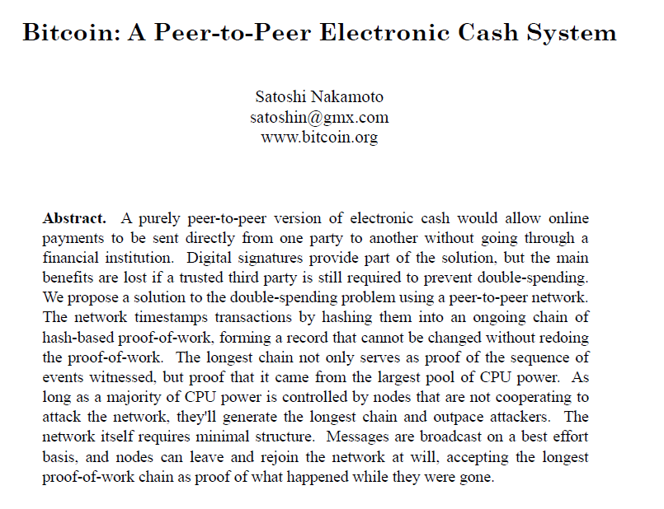
The Founder
Craig, Dorian, Hal, or Nick?
Electronic payment
system
P2P
No double
spending
Secure via
hash
Warning
about majority of
computing power
https://bitcoin.org/bitcoin.pdf
Published November 2008

Slide 24
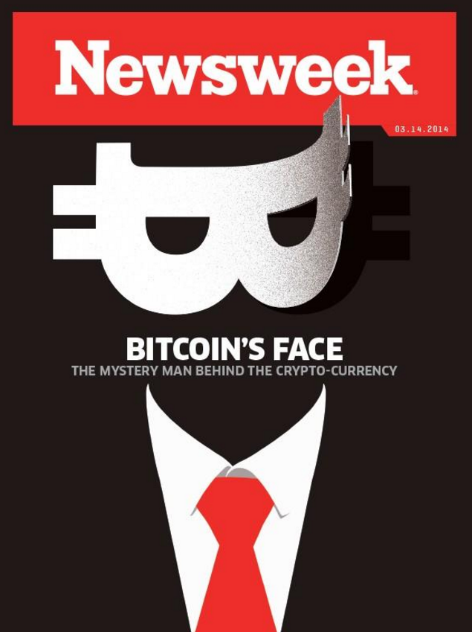

Slide 25
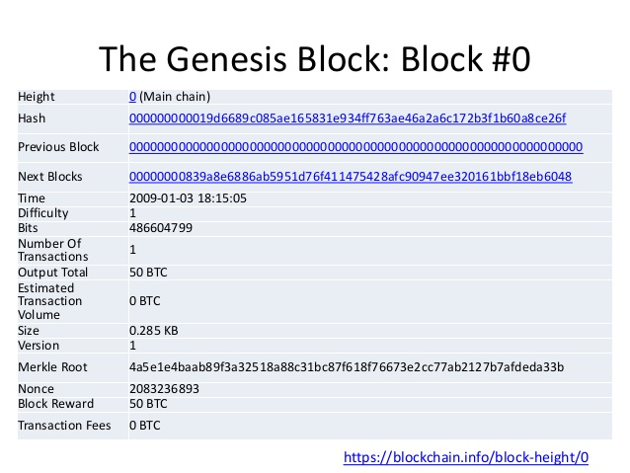
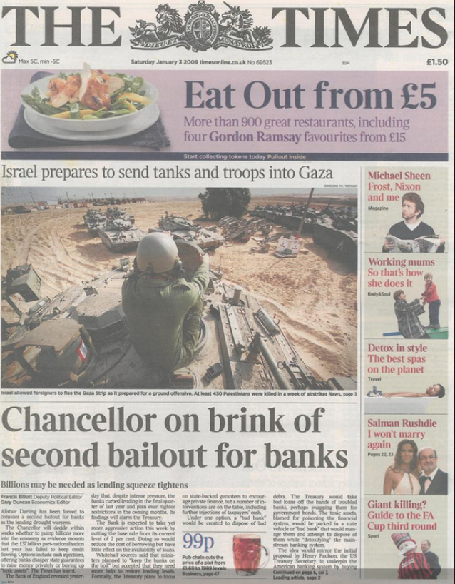
Genesis Block
The network was “started” January 3, 2009 with the Genesis Block

Slide 26
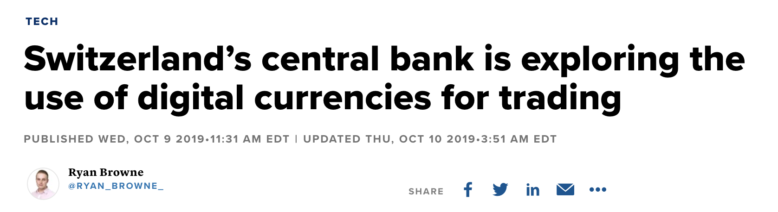
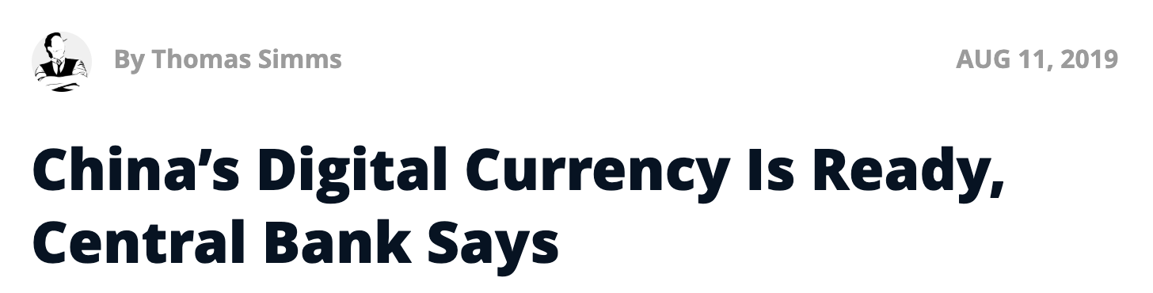
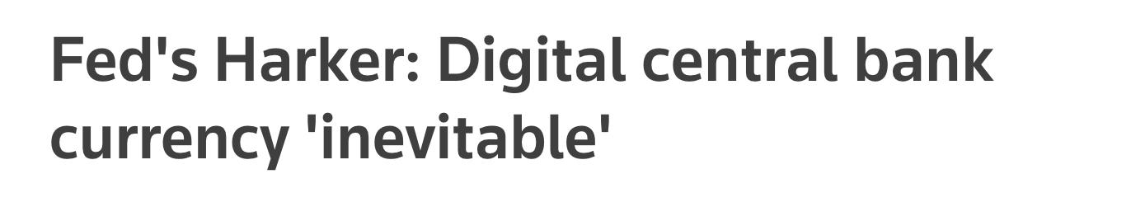
Central Bank Digital Currency (CBDC)
30 central banks actively working on retail CBDC
[BIS survey Jan. 2019]
Notes:
NSD: Russian National Settlement Depository.

Slide 27
What is a blockchain?
Layer 3:
user facing tools (cloud servers)
Layer 2:
applications (DAPPs, smart contracts)
Layer 1.5:
compute layer (blockchain computer)
Layer 1:
consensus layer

Slide 28
Consensus layer (informal)
achieved by replication
A public append-only data structure:
Persistence: once added, data can never be removed*
Consensus: all honest participants have the same data**
Liveness: honest participants can add new transactions
Open(?): anyone can add data (no authentication)
Layer 1:
consensus layer
Notes:
[Pass, Seeman, Shelat, 2016]
Blockchain data needs to be public: private blockchains are not part of this course.

Slide 29
This not a new problem …
State machine replication: studied since the 1980s
Google, Amazon, Bank of America, all have lots of servers:
need to ensure consistent state across all servers
Private blockchains
So what is new?
(a) new consensus protocols
the new aspect: a public blockchain
anyone can use, all data is public ⟹ interoperability, composability, verifiability
Notes:
Why impossible: sybil attack

Slide 30
How are blocks added to chain?
blockchain
signed
I am the leader
2 ETH
sk_{A}
verify
block
verify
block
sk_{B}
sk_{C}

Slide 31
How are blocks added to chain?
blockchain
…
2 ETH
I am the leader
sk_{A}
sk_{B}
2 ETH
sk_{C}
Notes:
Like a cloud service paid for by inflation.

Slide 32
Layer 1.5: The blockchain computer
DAPP logic is encoded in a program that runs on blockchain
Rules are enforced by a public program (public source code)
⇒ transparency: no single trusted 3rd party
The DAPP program is executed by parties who create new blocks
⇒ public verifiability: everyone can verify state transitions
Layer 1.5:
compute layer
Layer 1:
consensus layer

Slide 33
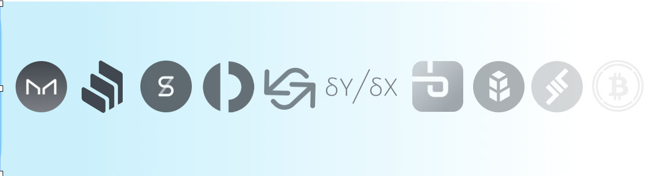
Layer 2: Decentralized applications (DAPPS)
Run on blockchain
computer
Layer 2:
applications (DAPPs, smart contracts)
Layer 1.5:
blockchain computer
Layer 1:
consensus layer

Slide 34
Layer 3: Common DAPP architecture
Layer 3: user facing servers
end user
blockchain computer
DAPP
DAPP
DAPP
(layer 2)
on-chain state
(layer 1.5)
consensus layer
(layer 1)

Slide 35
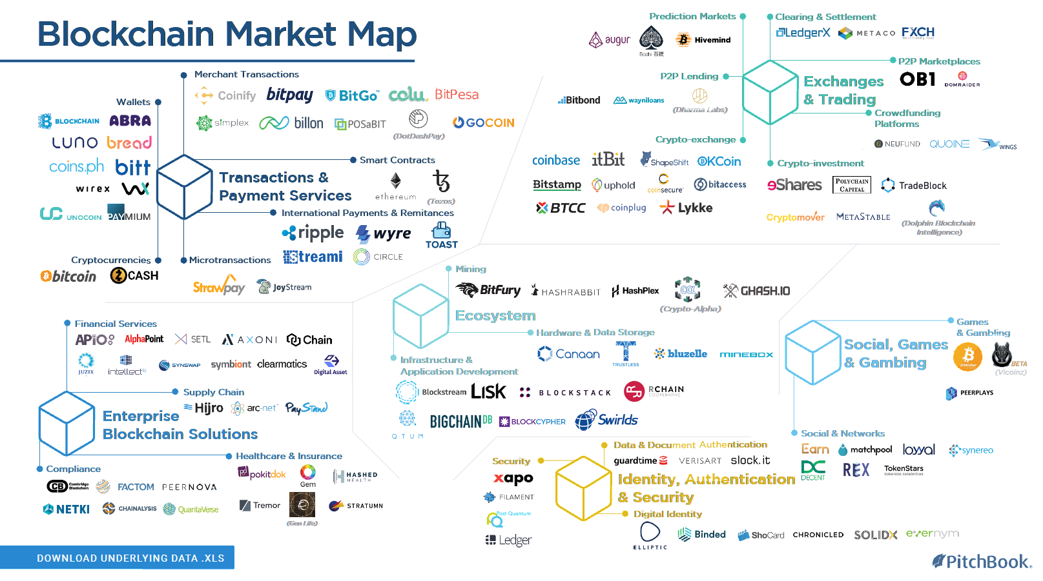

Slide 36
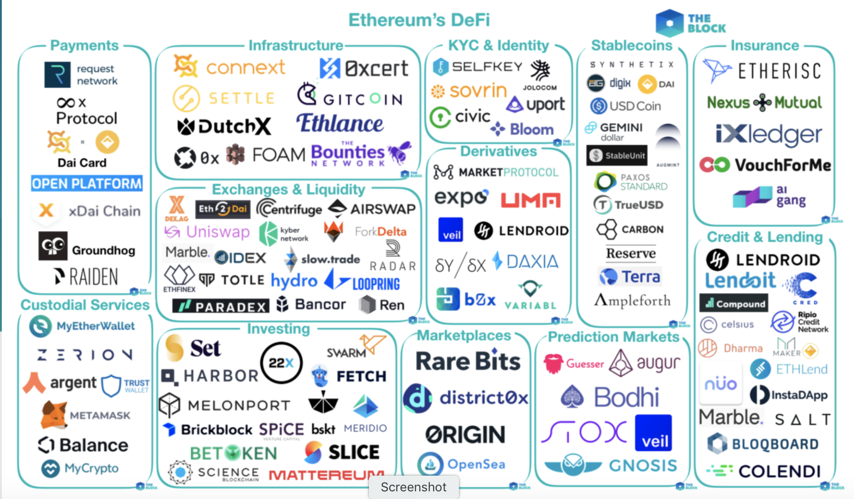
[source: the Block Genesis]
Notes:
By the end of the course: you will know how to write your own DAPP.

Slide 37
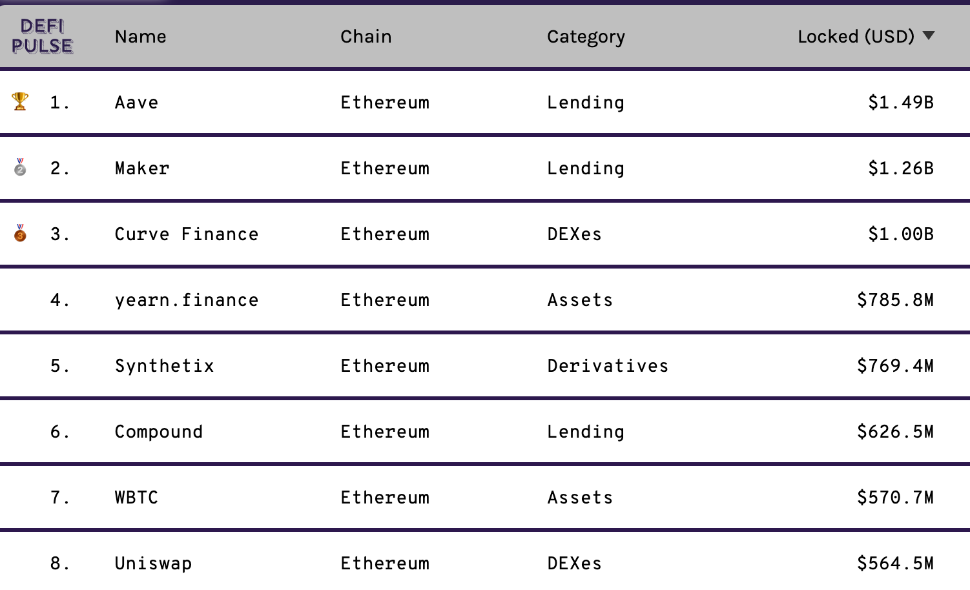
lots of experiments …

Slide 38
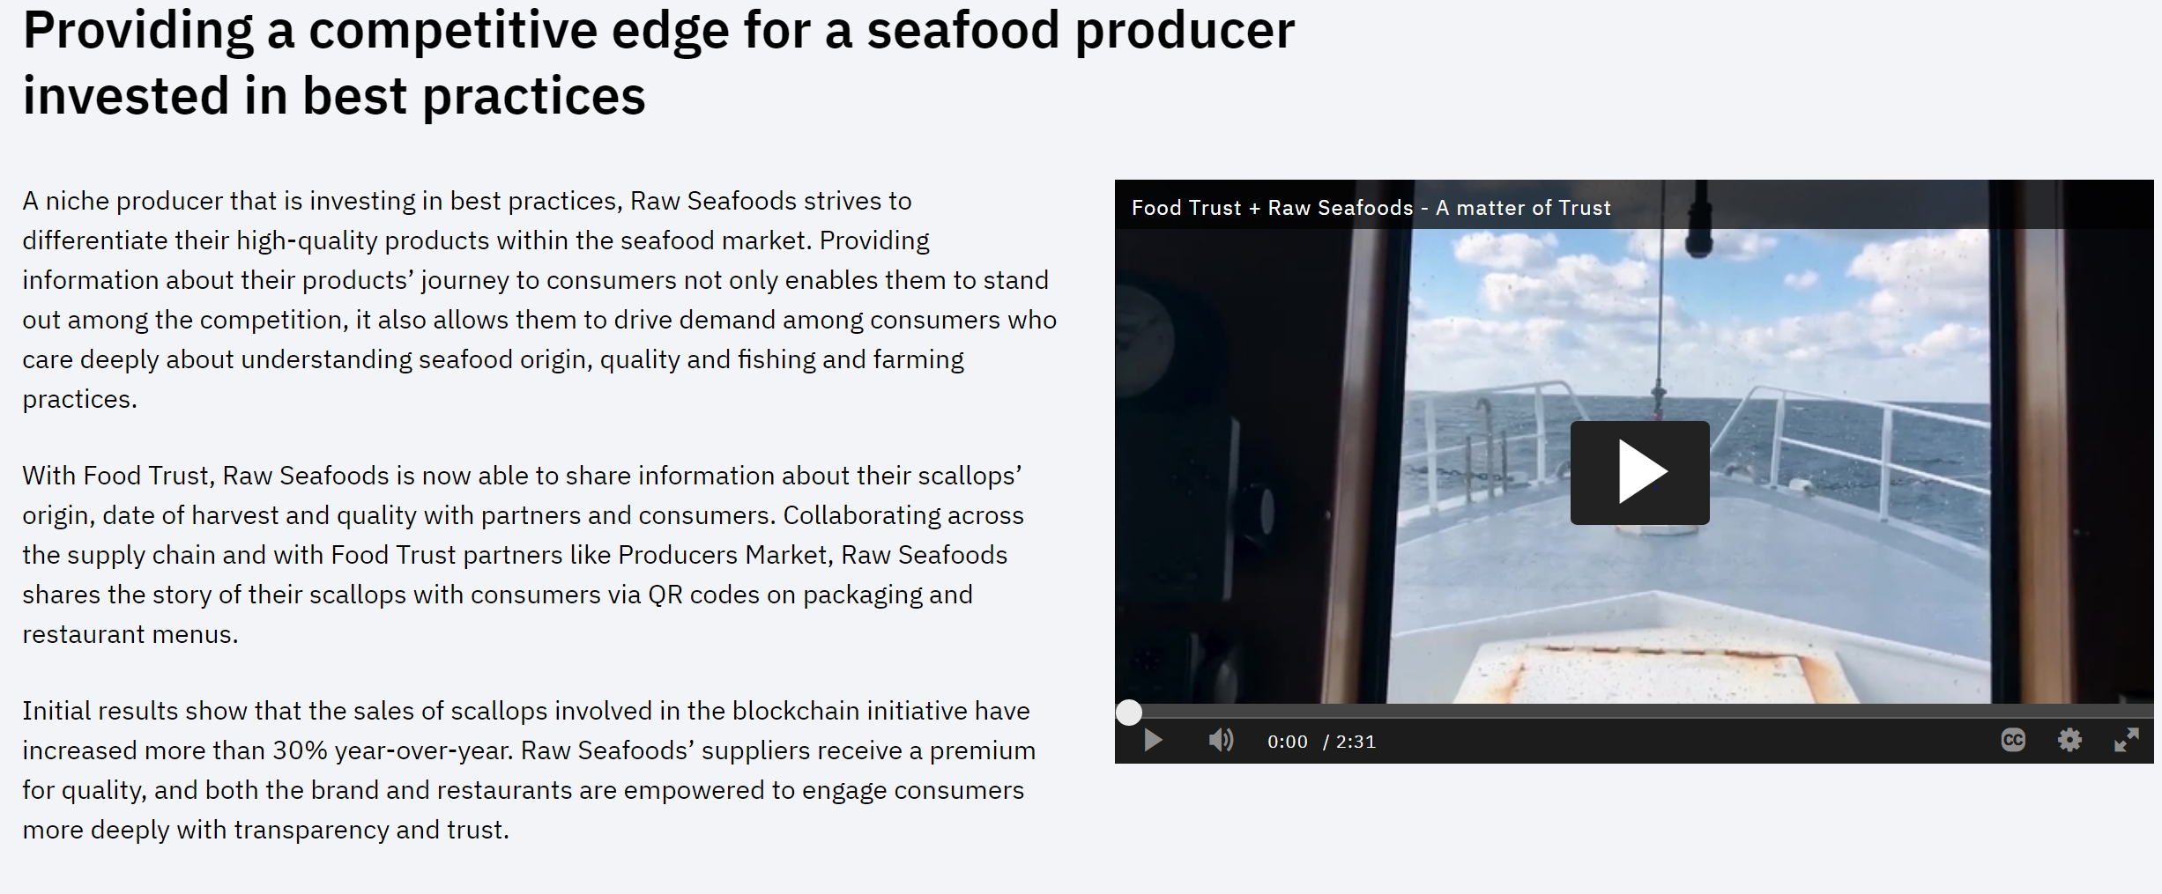

Slide 39
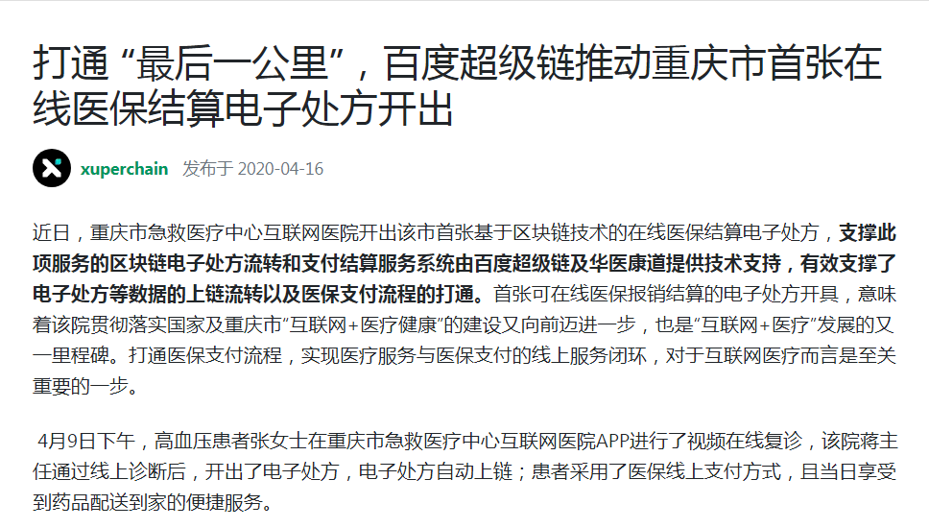
Applications
Notes:
Recently, the Internet Hospital of Chongqing Emergency Medical Center issued the city’s first online medical insurance settlement electronic prescription based on blockchain technology. Kangdao provides technical support, which effectively supports the on-chain circulation of data such as electronic prescriptions and the connection of the medical insurance payment process. The first electronic prescription issuance that can be used for online medical insurance reimbursement settlement means that the hospital has taken a step forward in implementing the national and Chongqing "Internet + medical health" construction, and is also another milestone in the development of "Internet + medical". Opening up the medical insurance payment process and realizing the closed loop of online services for medical services and medical insurance payment is a crucial step for Internet medical care.
On the afternoon of April 9, Ms. Zhang, a hypertensive patient, had a video online follow-up diagnosis on the APP of the Internet Hospital of Chongqing Emergency Medical Center. Director Jiang of the hospital issued an electronic prescription after the online diagnosis, and the electronic prescription was automatically on the chain; the patient used The online payment method for medical insurance has been improved, and the convenient service of delivering medicines to home on the same day can be enjoyed.

Slide 40
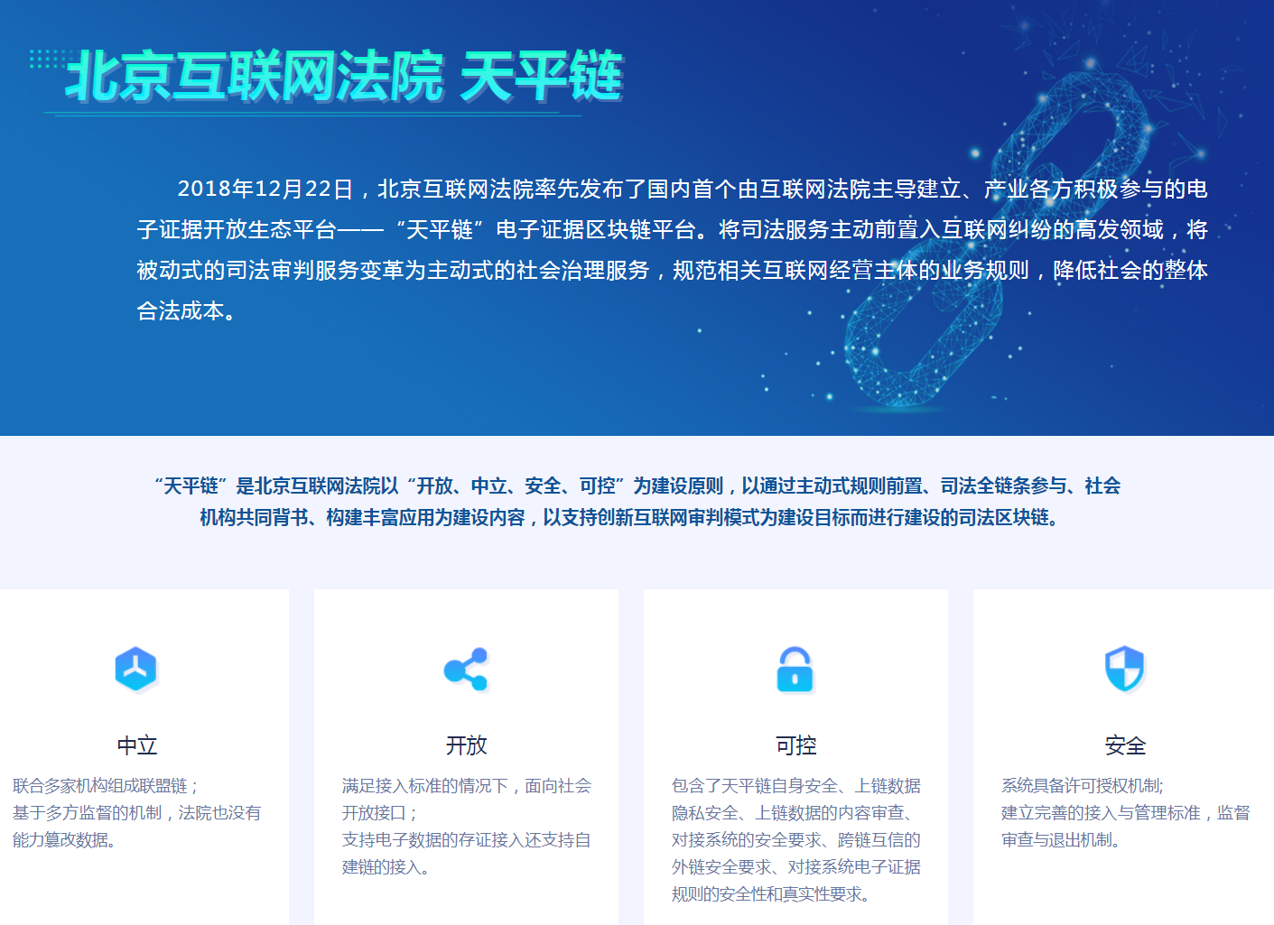
Notes:
On December 22, 2018, the Beijing Internet Court took the lead to release the first domestic electronic evidence open ecological platform led by the Internet court and actively participated by all parties in the industry-the "Tianping Chain" electronic evidence blockchain platform. Proactively advance judicial services into the high-incidence field of Internet disputes, transform passive judicial trial services into active social governance services, standardize the business rules of relevant Internet operators, and reduce the overall legal cost of society.

Slide 41
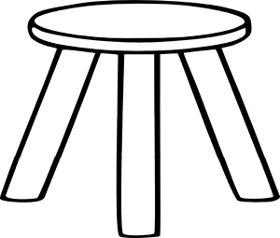
This course
Cryptography
Distributed systems
Economics

Slide 42
Course organization
The starting point: Bitcoin mechanics
Consensus protocols (public, consortium)
Ethereum and decentralized applications
decentralized applications

Slide 43
END OF LECTURE
Next lecture: the Bitcoin blockchain

